Slide 1
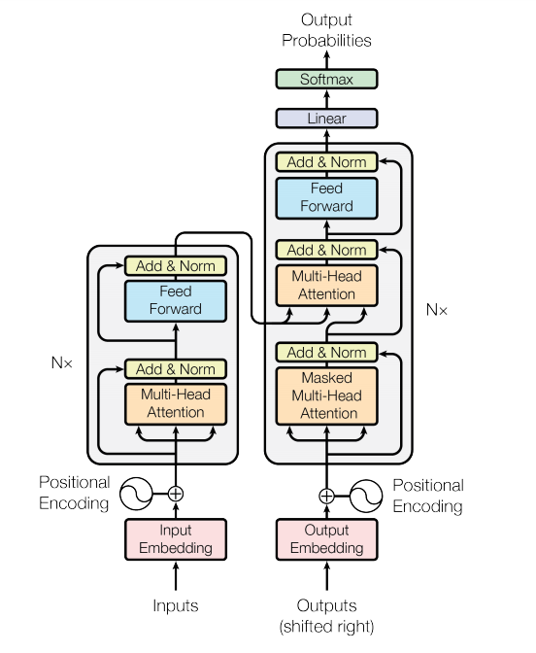
Transformers
Week 05: Read more material, a chapter from the book “ Deep Learning by Hugh Bishop” I confirmed how attention matrix Q,K, and V generated? Explain the embedding, tokenization and layering. Side 13, 14, and 15 (NEW)
Attention All You Need

Slide 2
Limitations of Previous Models
RNNs/LSTMs → sequential, slow, hard to parallelize
CNNs → better parallelization, but weak at long-range dependencies
NOTE: Transformers key idea is to remove recurrence & convolutions. Use only attention

Slide 3
Transformer Architecture
Encoder and Decoder Stacks
Encoder
Decoder
N =6 layers
N =6 layers
Notes:
The structure of the transformer, we divide it into two micro blocks.
The first part, Encoder: left
The second part, Decoder: right
Connected such that the information from the encoder send to the decoder.

Slide 4
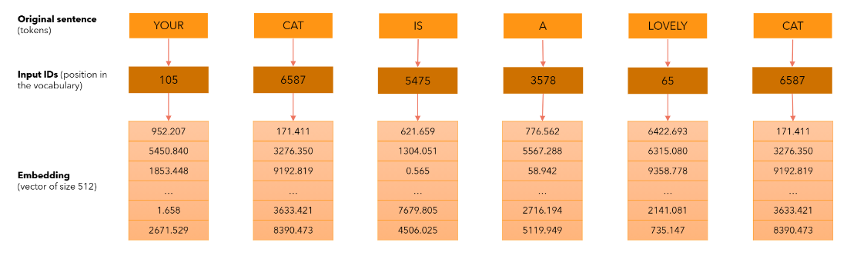
What is Input Embedding?
Notes:
Input sentence — token
Input ID: Number — position in the vocabulary
Input ID – input vector, embedding.
We define d mode = 512 which represent the size of embedding vector of each word.
Input ID will not change but input embedding will change according to the loss function.
Our model will learn to change the number in the embedding vectors in such a way it represents the meaning of the word. It is basically a mapping from single word to a mapping to 515 vector.

Slide 5
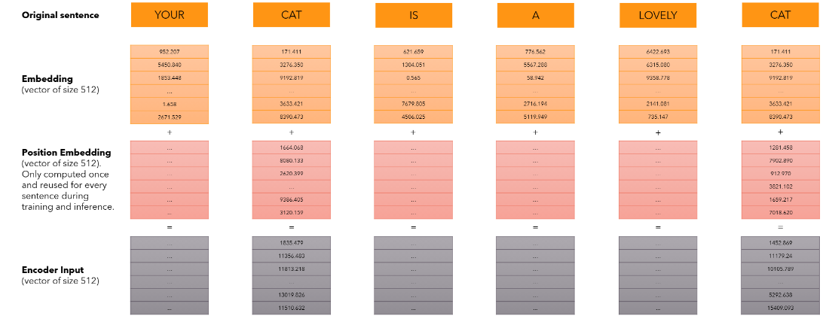
What is Positional Embedding?
Notes:
We want that each word to carry the information about its position in the sentence.
We want the model to treat words that appear close to each other “close” and words that are distant as “distant”
We want positional encoding to present a pattern that can learned by the model.
After creating the embedding vectors, we add another vector (positional vector). It is fixed and not learned. This vector represent the position of word in the sentence. It gives the output of vector of size 512.

Slide 6
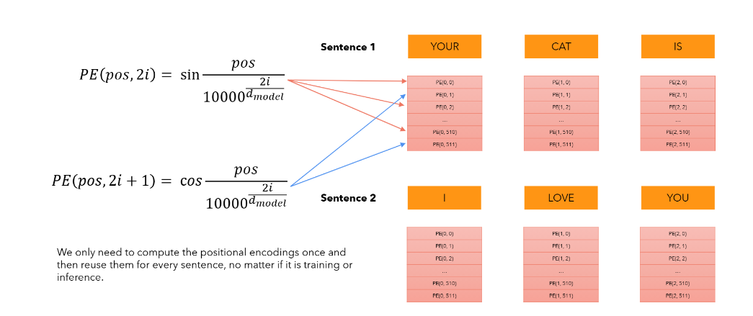
How Positional Embedding Vector Generated?

Slide 7
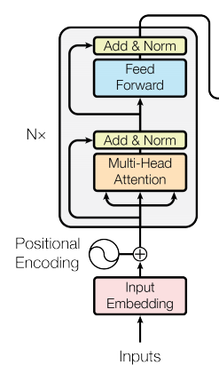
Encoder

Slide 8
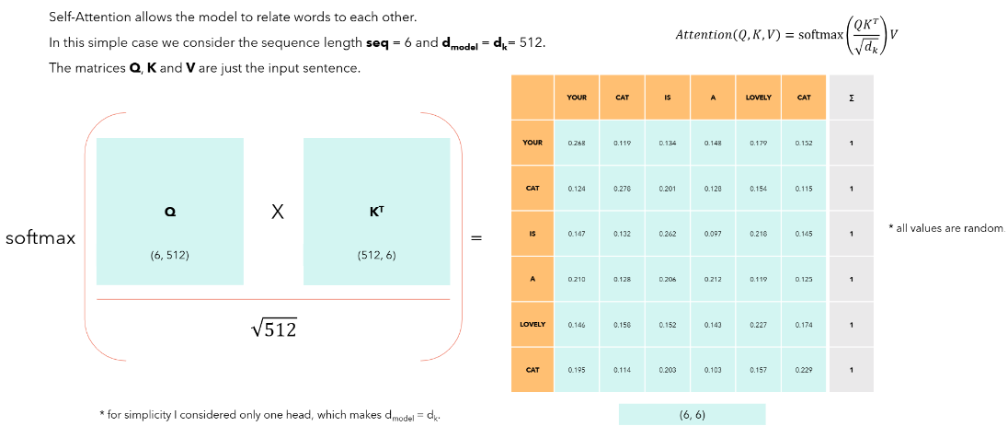
What is Self Attention?

Slide 9
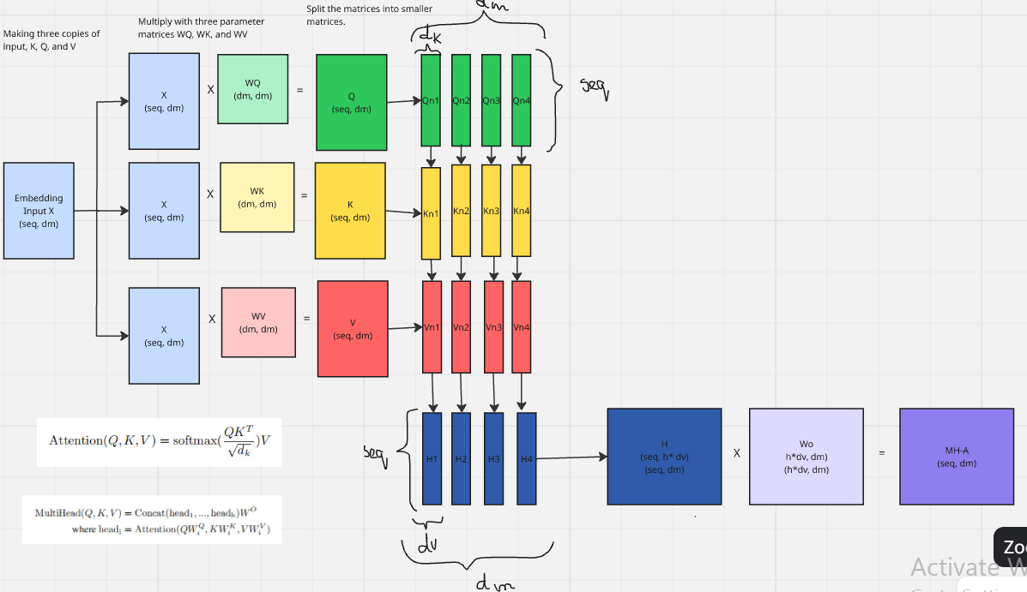
What is Multi-head Attention?

Slide 10
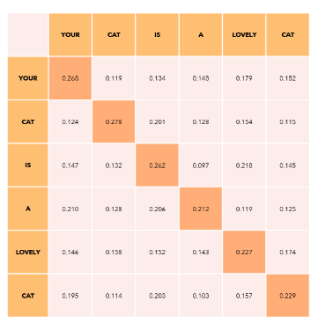
What is Masked Multi-Head Attention?
If we do not want some position to interact, we can always set the value to negative infinity before applying softmax the model will not learn those interactions.
Our goal is to make the model casual: it means that output at certain position can only depend on the words of the previous position. The model must not be able see the future words

Slide 11

Feed Forward Network
It is consist of two linear transformations with a ReLU activation in between.
Another way to define is two convolutions with kernel size 1

Slide 12
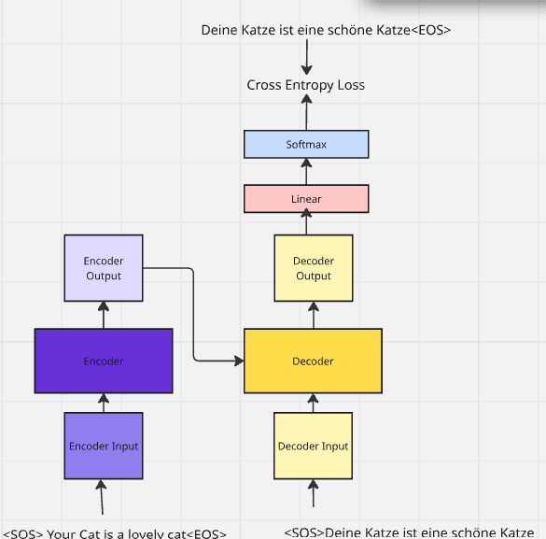
Training

Slide 13
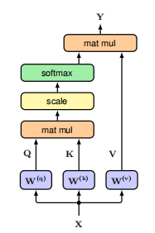
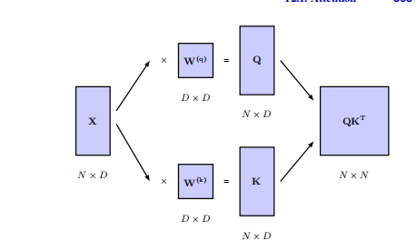
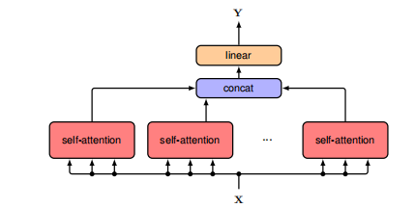
Attention

Slide 14
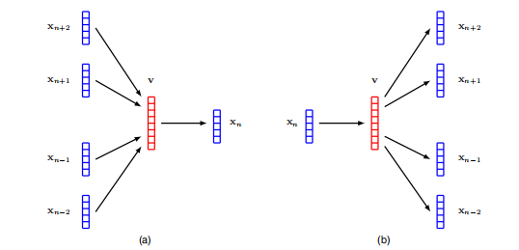
Word Embedding

Slide 15
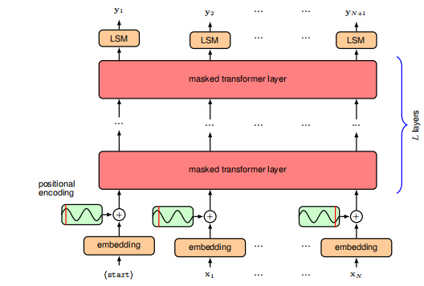
What Layering means? How it works

